Slide 1

Infrastruktura e serverEVe
server infrastructure
Osman Osmani
Prishtinë

Slide 2
server infrastructure
Topic 1 – Introduction (Server Infrastructure Concepts), Virtualization
Topic 2 –MS Editions, MS Services (AD)

Slide 3
server infrastructure
Topic 1 Recap
Microsoft Windows Server Editions
Microsoft Windows Server Services
Active Directory
MS Services/Roles
Using AD DS to organize your network
The power of Group Policy
Domain Name System (DNS)
DHCP versus static addressing
Back up and restore
MMC and MSC shortcuts
LAB Demo

Slide 4


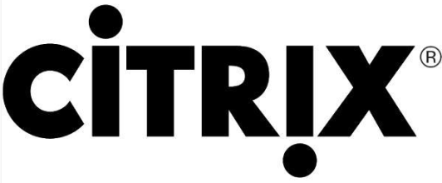
virtualization
What is Virtualization?
Virtualization is the process of creating a software-based or virtual, version of something.
Old but still relevant
Desktop Virtualization
Server Virtualization
Network Virtualization
Storage Virtualization
Application Virtualization

Slide 5
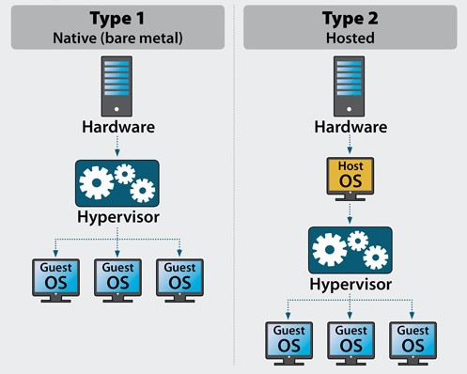
virtualization
Virtualization Types
Type 1 / Bare Metal
Type 2 / Hosted

Slide 6
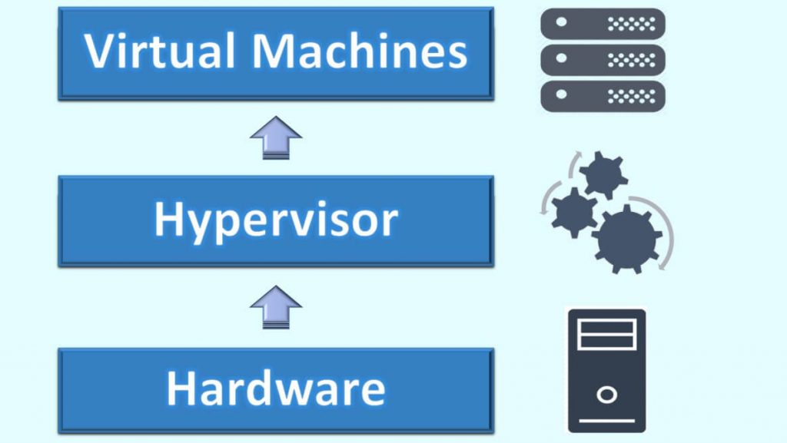
virtualization
What is a hypervisor?
A hypervisor, also called a virtual machine manager (VMM), is a program that allows multiple operating systems to share a single hardware host. Each operating system appears to have the host's processor, memory, and other resources all to itself. However, the hypervisor is actually controlling the host processor and resources, allocating what is needed to each operating system in turn and making sure that the guest operating systems (called virtual machines) cannot disrupt each other.

Slide 7

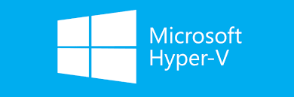


virtualization
Type 1 Hypervisors:
VMware vSphere / ESXi
Microsoft Hyper V
Xen / Citrix XenServer
Red Hat Enterprise Virtualization (RHEV)

Slide 8
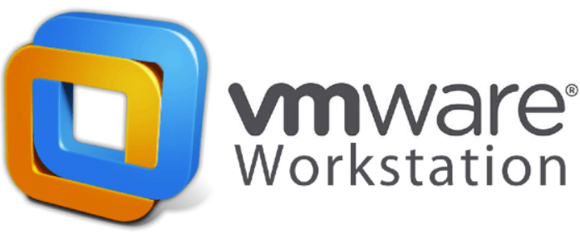
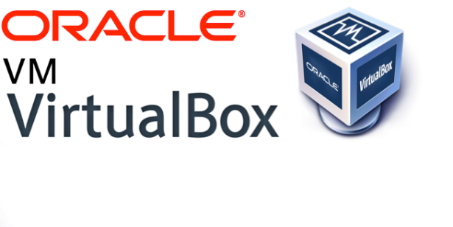
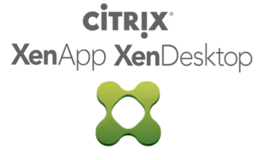
virtualization
Type 2 Hypervisors:
VMware Workstation
Microsoft Hyper V
Oracle VM VirtualBox
Citrix XenServer

Slide 9
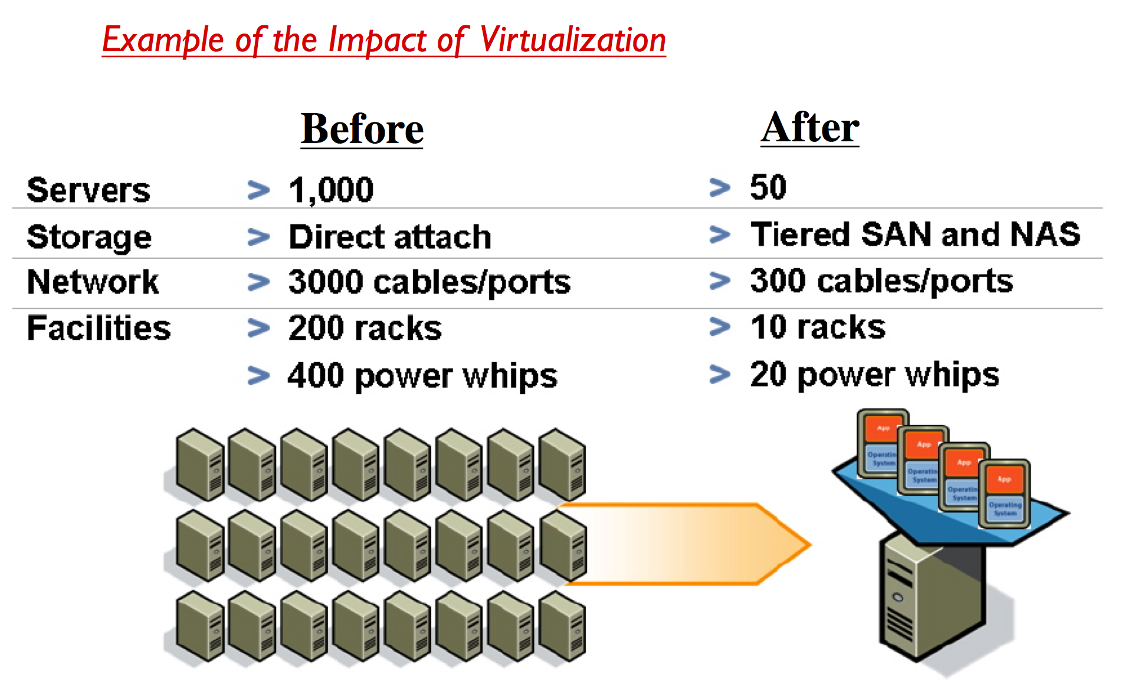
virtualization
Benefits from Virtualization:
Cost Savings
Flexibility
Centralization
Speed
Downtime
Disaster Recovery

Slide 10
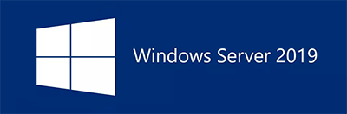
Microsoft Windows Server
Microsoft Windows Server
Versions (NT 3.1 – 2019)
Editions 2019 (Standard, Datacenter)
Releases
x86 - 2012
Update, Upgrade, Migrate

Slide 11
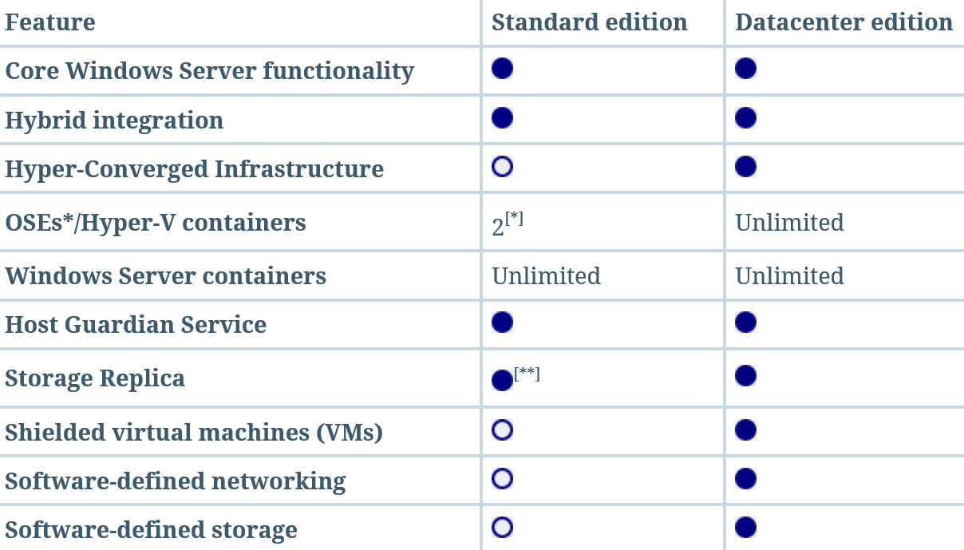
Microsoft Windows Server
Microsoft Windows Server - Editions

Slide 12
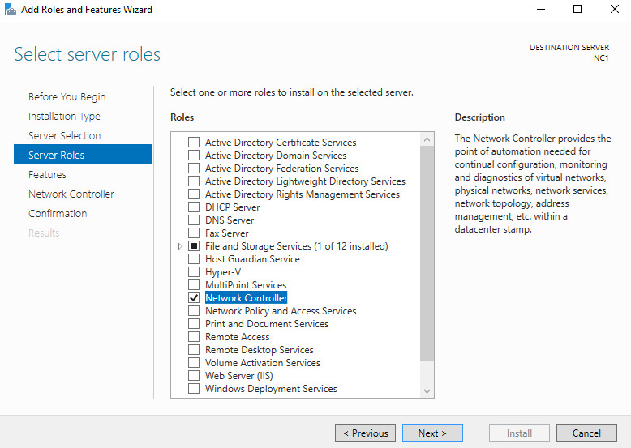
MICROSOFT WINDOWS SERVER Services
Microsoft Windows Server – Services / Roles

Slide 13
Active directory
Introduction to Active Directory

Slide 14
Module Overview
Active directory
Active Directory isn’t what it used to be!
What is Active Directory?
Active Directory Roles

Slide 15
What is Active Directory
Active directory
What is Active Directory?
A collection of services (Server Roles and Features) used to manage identity and access for and to resources on a network
Domain Services
Internal Accounts
Authorization
Authentication
Federation Services
Certificate Services
Network Access for External Resources
Identity
Non-Repudiation
Active Directory
Identity
Access
Centralized Management
Rights Management Services
Lightweight Directory Services
Content Security and Control
Application Templates
Notes:
2 minutes
Active Directory is a collection of services (Server Roles and Features) used to manage identity and access for and to resources on a network.

Slide 16
Active Directory Roles
Active directory
AD Domain Services (AD DS)
Users, Computers, Policies
AD Certificate Services (AD CS)
Service, Client, Server and User identification
AD Federation Services (AD FS)
Resource access across traditional boundaries
AD Rights Management Services (AD RMS)
Maintain security of data
AD Lightweight Directory Services (AD LDS)
Notes:
2 minutes
In the next few slides you will cover each of these Windows Roles with a summary of what each is and what each does.

Slide 17
What is AD DS?
Active directory
Windows Server
What is Active Directory Domain Services?
A directory service is both the directory information source and the service that makes the information available and usable
A phone book…
Mgmt Profile
Network Info
Printers
Shares
Windows User
Windows Client
Account Information
Privileges
Profiles
Policies
Mgmt Profile
Network Info
Policies
Active Directory Domain Services
Manageability
Security
Interoperability
Email Servers
Network Devices
Mailbox Information
Address Book
Applications
Config
QoS Policy
Security Policy
Server Config
SSO
App-Specific Directory Info
Notes:
5 Minutes
Use the phone book

Slide 18
What does AD DS do?
Active directory
Scalable, secure, and manageable infrastructure for user and resource management
stores and manages information about network resources
provides support for directory-enabled applications such as Microsoft® Exchange Server
allows for centralized management

Slide 19
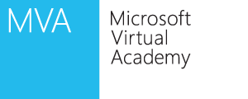
What is AD CS?
Active directory
AD CS is the Microsoft implementation of Public Key Infrastructure (PKI)
PKI is a set of hardware, software, people, policies, and procedures needed to create, manage, distribute, use, store, and revoke digital certificates
Certificate Signing Request
2
Enrollment
Certificate Repository
3
x.509 Certificate Chain
End-Entities (users or computers)
Certification Revocation Repository
Certificate Retrieval
4
1
CRL Retrieval
Certificate Revocation List
5
Revocation Request
Notes:
End-entity - the end-user consumers of PKI services. This could be a person, or a computer.
Certificate Authority (CA) – Trusted party responsible for the management of digital certificates. The CA is the center of the PKI trust model. A CA is responsible for issuing signed digital certificates, maintaining a certificate repository, and managing revoked certificates and the public list of those certificates, the certificate revocation list (CRL).
Certificate Signing Request (CSR) - a document generated by an end-entity used to enroll for a certificate. The request contains information about the user such as distinguished name and public key (signature).
Public Digital Certificate and Certificate Path - a digital certificate is the public component in PKI. A public certificate represents the credentials for a given end-entity by connecting an entity to a specific public key. The end-entity represented holds the private key that corresponds to that certificate. Certificates can be used for a number of security measures such as digital signatures to verify the origin, integrity of information, and non-repudiation.
Certificate Revocation List (CRL) - a list of revoked certificates. This list is checked during certificate verification by a certificate holder to verify the revocation status for a given certificate. Online Certificate Status Protocol (OCSP) is a CRL alternative that can be used to retrieve revocation and status information for a certificate as well.

Slide 20
What does AD CS do?
Active directory
AD CS provides customizable services for issuing and managing digital certificates
Certification Authorities
CA Web Enrollment
Online Responders
Network Device Enrollment Service (NDES)
Certificate Enrollment Web Service
Certificate Enrollment Policy Web Service
Notes:
By using Server Manager, you can install the following components of AD CS:
Certification authorities (CAs)
CAs issue certificates to users, computers, and services, and manage certificate validity
CA Web enrollment
Web enrollment allows users to connect to a CA by means of a Web browser in order to request certificates and retrieve certificate revocation lists (CRLs)
Online Responder
The Online Responder service sends a signed response containing requested certificate status information to clients
Network Device Enrollment Service
The Network Device Enrollment Service allows network devices to obtain certificates when they don’t have domain accounts
Certificate Enrollment Web Service
The Certificate Enrollment Web Service allows for certificate enrollment by users and computers using SSL to enables policy-based certificate enrollment for disconnected or non-domain-joined computers and users
Certificate Enrollment Policy Web Service
Delivers certificate enrollment policy information to computers and users to enable the Certificate Enrollment Web Service

Slide 21
What does AD FS do?
Active directory
The AD FS server role provides simplified, secured identity federation and Web single sign-on (SSO) capabilities.
enables the creation of trust relationships between two organizations
provides access to applications between organizations
provides Single Sign-on (SSO) between two different directories for Web-based applications
Notes:
AD FS simplifies end-user access to systems and applications by using a claims-based access authorization mechanism to maintain application security. You can deploy AD FS to:
Provide your employees or customers with seamless access to Web-based resources in any federation partner organization on the Internet without requiring employees or customers to log on more than once
Retain complete control over your employee or customer identities without using other sign-on providers (Windows Live ID, Liberty Alliance, and others)
Provide your employees or customers with a Web-based, SSO experience when they need remote access to internally hosted Web sites or services
Provide your employees or customers with a Web-based, SSO experience when they access cross-organizational Web sites or services from within the firewalls of your network
Identity Federation allows for separate authentication domains or realms to be able to share resources without having to provide complete access to each of the authentication domains. In the real world everyone has a number of usernames and passwords that they must remember, even in the same organizations or within partner organizations. Identity federation allows for different authentication domains/realms to provide single sign-on (SSO) services. This can be done without creating a full Active Directory trust between the organizations.

Slide 22

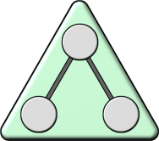

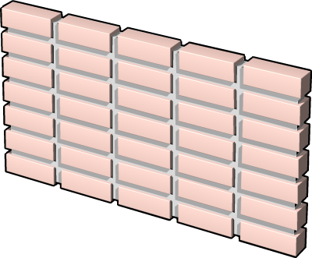

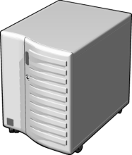
What is AD FS?
Active directory
A software component that facilitates the cross-organizational access of systems and applications
AD DS
Web Server
Federation Trust
Account Federation Server
Resource Federation Server
Resource Partner Organization
Account Partner Organization

Slide 23



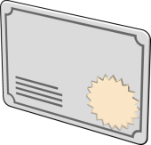








What is AD RMS?
Active directory
Active Directory Rights Management Services (AD RMS) is an information protection technology that works with applications to safeguard digital information
RMS Server
Information Author
Recipient

Slide 24
What does AD RMS do?
Active directory
Allows individuals and administrators to specify access permissions to documents, workbooks, and presentations
prevent sensitive information from being printed, forwarded, or copied by unauthorized people
access and usage restrictions are enforced no matter where the information is located
Notes:
A rights-management solution protects information stored in documents, e-mail messages, and Web sites from unauthorized viewing, modification, or use.
Features typically include:
Protecting sensitive information from being accessed or shared with unauthorized users by preventing users from forwarding or copying content
Ensuring that data content is protected and tamper-resistant using encryption and digital signatures
Controlling when data will expire based on time requirements, even when that information is sent over the Internet to other individuals - ensuring that the most current information is used

Slide 25
What is AD LDS?
Active directory
AD LDS is a hierarchical file-based directory store
AD LDS is both the directory information source and the service that makes the information available and usable
Network Devices
Windows User
Account Information
Privileges
Profiles
Policies
Config
QoS Policy
Security Policy
Active Directory LDS
Manageability
Security
Interoperability
Email Servers
Applications
Server Config
SSO
App-Specific Directory Info
Mailbox Information
Address Book
Notes:
The image here was also used in the slide regarding AD DS. It was left in place here intentionally to demonstrate the similarities between AD DS and AD LDS.

Slide 26
What does AD LDS do?
Active directory
Lightweight Directory Access Protocol (LDAP)
Directory service that provides flexible support for directory-enabled applications, without the dependencies and domain-related restrictions of AD DS
provide directory services for directory-enabled applications without incurring the overhead of domains and forests
no requirement for a single schema throughout a forest
Notes:
Active Directory Lightweight Directory Services (AD LDS) provides a Lightweight Directory Access Protocol (LDAP) compliant directory and associated services. It is used to provide authentication and directory services for custom written, third-party and other enterprise applications.

Slide 27








What is Authorization?
Authorization is a process of verifying that an authenticated user has permission to perform an action
Security principals are issued security identifiers (SIDs) when the account is created
User accounts are issued security tokens during authentication that include the user’s SID and all related group SIDs
Shared resources on a network include access control lists (ACL) that define who can access the resource
The security token is compared against the Discretionary Access Control List (DACL) on the resource and access is granted or denied
Notes:
Some of the types of attributes that might be contained in the security token are user group, ownership, and admin privileges.
The security identifier (SID) attribute is unique for each user or security group, and is the primary means by which the security principal is identified when trying to access network resources.
Authorization happens frequently and unobtrusively whenever users request services, like opening their home folder, reading/writing files, or when requesting access to an AD DS aware application. The user only sees the result of the authorization--they are granted or denied access.
An access control list (ACL) is a list of access control entries (ACE). Each ACE in an ACL identifies a security principal and the access rights allowed, denied, or audited for that principal. The security descriptor for a securable object can contain two types of ACLs: a DACL and a SACL.
A discretionary access control list (DACL) identifies the security principals that are allowed or denied access to an object. When a person or process tries to access an object, the system checks the ACEs in the object's DACL to determine whether to grant access to it. If the object does not have a DACL, the system grants full access to everyone. If the object's DACL has no ACEs, the system denies all attempts to access the object because the DACL does not allow any access rights.
A system access control list (SACL) enables administrators to log attempts to access a secured object. Each ACE specifies the types of access attempts by a specified principal that cause the system to generate a record in the security event log. An ACE in a SACL can generate audit records when an access attempt fails, when it succeeds, or both.

Slide 28
Why Deploy AD DS?
AD DS provides a centralized system for managing users, computers, and other resources on a network
AD DS features include:
Centralized directory
Single sign-on access
Integrated security
Scalability
Common management interface

Slide 29
Centralized Network Management
AD DS centralizes network management by providing:
Single location and set of tools for managing user and group accounts
Single location for assigning access to shared network resources
Directory service for AD DS enabled applications
Options for configuring security policies that apply to all users and computers
Group policies to manage user desktops and security settings

Slide 30
Requirements for Installing AD DS
Object | Description
TCP/IP | Configure appropriate TCP/IP and DNS server addresses.
Credentials | To install a new AD DS forest, you need to be local Administrator on the server. To install an additional domain controller in an existing domain, you need to be a member of the Domain Admins group.
Domain Name System )DNS) Infrastructure | Verify that a DNS infrastructure is in place. When you install AD DS, you can include DNS server installation, if it is needed. When you create a new domain, a DNS delegation is created automatically during the installation process. Creating a DNS delegation requires credentials that have permissions to update the parent DNS zones.

Slide 31


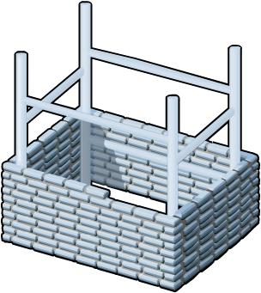




Overview of AD DS and DNS
AD DS requires a DNS infrastructure
AD DS domain names must be DNS domain names
DNS Domain Name
DNS
AD DS domain controller records must be registered in DNS to enable other domain controllers and client computers to locate the domain controllers
DNS zones can be stored in AD DS as Active Directory integrated zones
DNS Zone

Slide 32
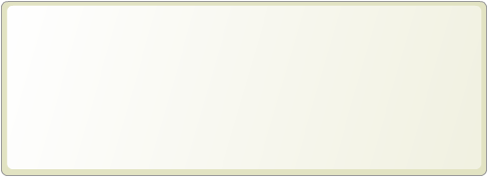
Component Overview
AD DS is composed of both physical and logical components
Physical Components | Logical Components
Data store Domain controllers Global catalog server Read-Only Domain Controller (RODC) | Partitions Schema Domains Domain trees Forests Sites Organizational units (OUs)
Notes:
Physical components
Data store: Stores the AD DS information. This is a file on each domain controller.
Domain Controller Server and read-only domain controller (RODC): Contains a copy of AD DS database.
Global catalog servers: Host the global catalog, which is a partial, read-only copy of all the domain naming contexts in the forest. A global catalog speeds up searches for objects that might be attached to other domain controllers in the forest.
Logical components
Partitions: Various partitions exist in AD DS: domain directory, configuration directory, schema directory, global catalog, application directory.
Schema: Defines the list of attributes which all objects in the AD DS can have.
Domains: logical, administrative boundary for users and computers
Domain Trees: Collection of domain controllers that share a common root domain.
Forests: Collections of domains that share a common AD DS.
Sites: Collections of users, groups, computers as defined by their physical locations. Useful in planning administrative tasks such as replication of the AD DS.
OUs: Organizes the elements found at a give site or domain for the purposes of securing them more selectively.

Slide 33
Lesson 2: Overview of AD DS Physical Components
Active directory
Domain Controllers
Global Catalog Servers
Data Store
Replication
Sites

Slide 34


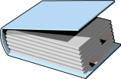
Domain Controllers
A domain controller is a server with the AD DS server role installed that has specifically been promoted to a domain controller
Domain controllers:
Host a copy of the AD DS directory store
Provide authentication and authorization services
Replicate updates to other domain controllers in the domain and forest
Allow administrative access to manage user accounts and network resources
Windows Server 2008 and later supports RODCs
Notes:
Each domain controller holds a copy of the directory store, and updates can be made to the AD DS data on all domain controllers except for RODCs.
Have multiple domain controllers in each domain. This provides load balancing, but more importantly, it also provides recoverability if a server failure occurs.
All domain controllers engage in authentication and authorization, thus making it a redundant system with fewer fail-points.

Slide 35


Global Catalog Servers
Global catalog servers are domain controllers that also store a copy of the global catalog
The global catalog:
Contains a copy of all AD DS objects in a forest that includes only some of the attributes for each object in the forest
Improves efficiency of object searches by avoiding unnecessary referrals to domain controllers
Required for users to log on to a domain
Notes:
The global catalog partition is like other partitions in AD DS, but unlike other partitions, administrators cannot enter information directly into this partition. The global catalog builds and updates its content based on values of a schema attribute (isMemberOfPartialAttributeSet), thus deciding when to replicate that attribute of an AD DS object in the global catalog.
Note that the alternative to having a searchable global catalog would be much more traffic over the entire organization’s network.

Slide 36
What is the AD DS Data Store?
The AD DS data store contains the database files and processes that store and manage directory information for users, services, and applications
The AD DS data store:
Consists of the Ntds.dit file
Is stored by default in the %SystemRoot%\NTDS folder on all domain controllers
Is accessible only through the domain controller processes and protocols
Notes:
The NTDS.DIT file is a database with usually 3 or more tables. The name and purpose of the important tables are the following:
1. datatable - used to store the objects accessible in Active Directory
2. link_table - used to provide references to objects (introduced with Server 2003)
3. sd_table - used to store the security descriptors
The database engine for NTDS.DIT is the Extensible Storage Engine (ESE or JET Blue) and is a proprietary Microsoft database engine. This engine is also used in Microsoft Exchange, however, the pagesizes are different between the two databases. It is 8192 bytes in the NTDS.DIT database and 4096 bytes in Exchange.
The AD DS database cannot be directly accessed by any applications. All access to the database is managed by the domain controller.
64-bit hardware can provide a significant performance boost for domain controllers because of the increase in addressable memory space.

Slide 37
What is AD DS Replication?
AD DS replication copies all updates of the AD DS database to all other domain controllers in a domain or forest
AD DS replication:
Ensures that all domain controllers have the same information
Uses a multimaster replication model
Can be managed by creating AD DS sites
The AD DS replication topology is created automatically as new domain controllers are added to the domain
Notes:
If directory information did not replicate regularly:
logons would fail at domains other than where the user account was created
locations and names of domain controllers might not be current, causing services contained on them to become unavailable
Advantages of multi-master replication include:
the elimination of single point of failure
faster replication as each domain controller can be involved with replicating data
Domain controllers in the same site replicate their data, typically within 15 seconds after a change, completing replication with all members in a properly configured tree in about 45 seconds.
When you create multiple sites, you can configure a replication schedule between the sites.

Slide 38
What are Sites?
An AD DS site is used to represent a network segment where all domain controllers are connected by a fast and reliable network connection
Sites are:
Associated with IP subnets
Used to manage replication traffic
Used to manage client logon traffic
Used by site aware applications such as Distributed File Systems (DFS) or Exchange Server
Used to assign group policy objects to all users and computers in a company location
Notes:
Sites are often defined after an analysis of network bandwidth capacity.
The primary reason for creating sites is to control network traffic across wide area network (WAN) links. By creating sites, you can minimize replication traffic across the WAN link because you can schedule the replication. You also control client logon traffic and provide a better client logon experience because client computers will always connect to a domain controller in their own site first.

Slide 39
Overview of AD DS Logical Components
AD DS Schema
The Basics
Trusts
AD DS Objects
Demo: Installation and Management

Slide 40
What is the AD DS Schema?
The AD DS Schema:
Defines every type of object that can be stored in the directory
Enforces rules regarding object creation and configuration
Object Types | Function | Examples
Class Object | What objects can be created in the directory | User Computer
Attribute Object | Information that can be attached to an object | Display name
Notes:
One of the easiest ways to describe the schema is to say that it is a set of rules that define what you can do in AD DS.
ADSIEdit and the Schema Management Console are tools you can use to manage the schema. You must register the Schema snap-in by using the regsvr32 schmmgmt.dll command before creating the custom MMC.

Slide 41

The Basics: Domains
Domains are used to group and manage objects in an organization
Contoso.com
Domains:
An administrative boundary for applying policies to groups of objects
A replication boundary for replicating data between domain controllers
An authentication and authorization boundary that provides a way to limit the scope of access to resources

Slide 42
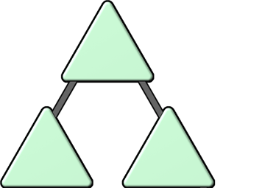
The Basics: Trees
A domain tree is a hierarchy of domains in AD DS
contoso.com
emea.contoso.com
na.contoso.com
All domains in the tree:
Share a contiguous namespace with the parent domain
Can have additional child domains
By default create a two-way transitive trust with other domains

Slide 43
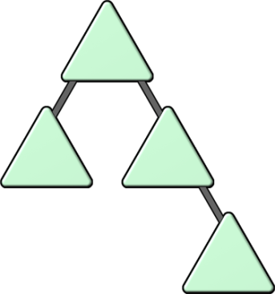

The Basics: Forests
A forest is a collection of one or more domain trees
Forests:
Share a common schema
Share a common configuration partition
Share a common global catalog to enable searching
Enable trusts between all domains in the forest
Share the Enterprise Admins and Schema Admins groups

Slide 44

The Basics: Organizational Units (OUs)
OUs are Active Directory containers that can contain users, groups, computers, and other OUs
OUs are used to:
Represent your organization hierarchically and logically
Manage a collection of objects in a consistent way
Delegate permissions to administer groups of objects
Apply policies
Notes:
OUs can be used to create both a hierarchical and logical representation of a company. OUs can also be used to delegate certain administrative rights. For example, a junior network administrator may be given permission to administer user accounts in an OU that contains all accounts for a branch office location.

Slide 45


Trusts
Trusts provide a mechanism for users to gain access to resources in another domain
Types of Trusts | Description | Diagram
Directional | The trust direction flows from trusting domain to the trusted domain
Transitive | The trust relationship is extended beyond a two-domain trust to include other trusted domains
Access
TRUST
Trust & Access
All domains in a forest trust all other domains in the forest
Trusts can extend outside the forest
Notes:
The trusted domain as the domain where the accounts are, and the trusting domain as where the shared resources are.
Domains can allow access to shared resources outside of their boundaries by using a trust. You can use a one-way trust to optimize performance between domains. Mention that forest trusts allow users to access resources in any domain in the other forest, as well as logon to any domain in the forest using a same VPN.
Realm trusts enable trusts between Windows Server 2003 and Windows Server 2008 domains and directory-service implementations on other platforms by their shared use of open standard security system Kerberos version 5 protocol.

Slide 46
AD DS Objects
Object | Description
User | Enables network resource access for a user
InetOrgPerson | Similar to a user account Used for compatibility with other directory services
Contacts | Used primarily to assign e-mail addresses to external users Does not enable network access
Groups | Used to simplify the administration of access control
Computers | Enables authentication and auditing of computer access to resources
Printers | Used to simplify the process of locating and connecting to printers
Shared folders | Enables users to search for shared folders based on properties

Slide 47
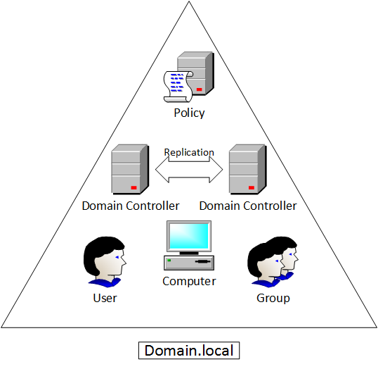
Overview of AD DS Logical Components
Units of Replication
Maintained by Domain Controllers
Millions of Objects
Notes:
All of the domain controllers in a particular domain can receive changes and replicate those changes to all other domain controllers in the domain. Each domain in Active Directory is identified by a Domain Name System (DNS) domain name and requires one or more domain controllers.

Slide 48
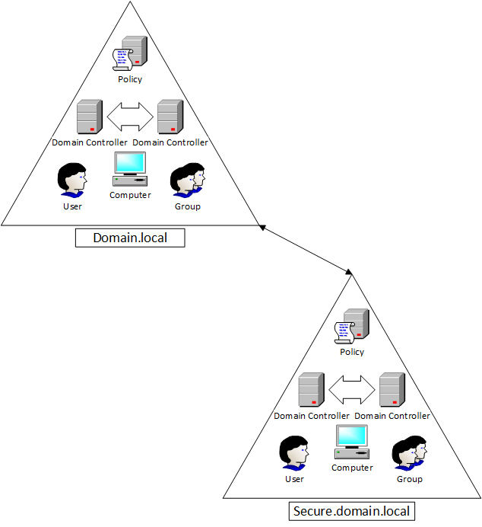
Trees

Slide 49
DEMO: Installation and Management
Observe the installation of AD DS
Installation occurs without promotion to a domain controller
Domain Controller Promotion
Active Directory Users and Computers
Active Directory Administrative Center
Active Directory Sites and Services

Slide 50
Using AD DS to organize your network
There is not a single tool that is used to manage all facets of Active Directory.
Active Directory Users and Computers
Active Directory Domains and Trusts
Active Directory Sites and Services
Active Directory Administrative Center

Slide 51
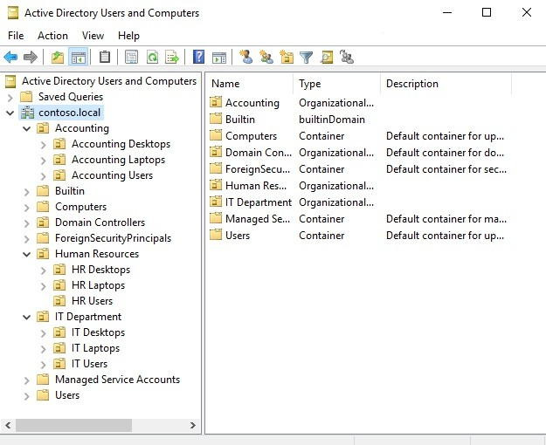
Active Directory Users and Computers
OUs
User accounts
Security Groups
Computer accounts
Printers

Slide 52
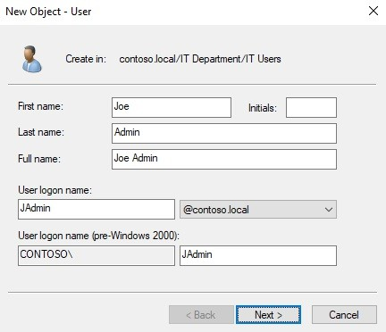
Active Directory Users and Computers
OUs
User accounts
Security Groups
Computer accounts
Printers

Slide 53
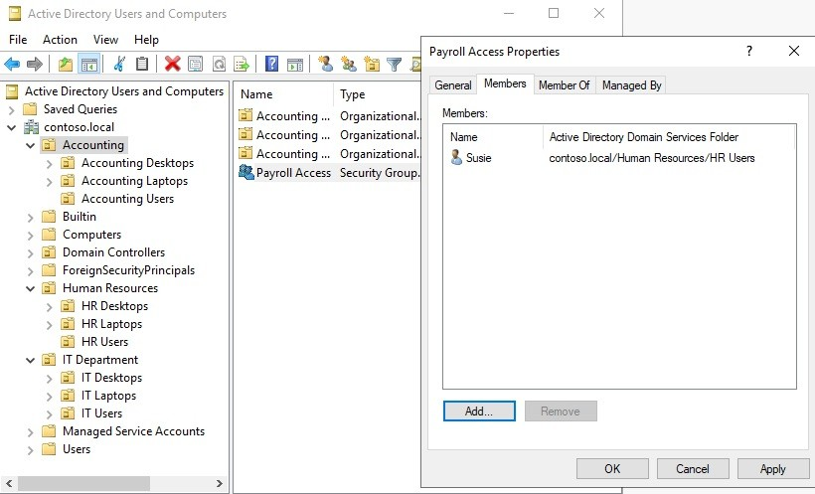
Active Directory Users and Computers
OUs
User accounts
Security Groups
Computer accounts
Printers

Slide 54
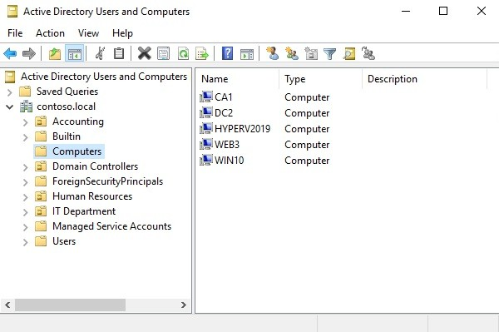
Active Directory Users and Computers
OUs
User accounts
Security Groups
Computer accounts
Printers

Slide 55
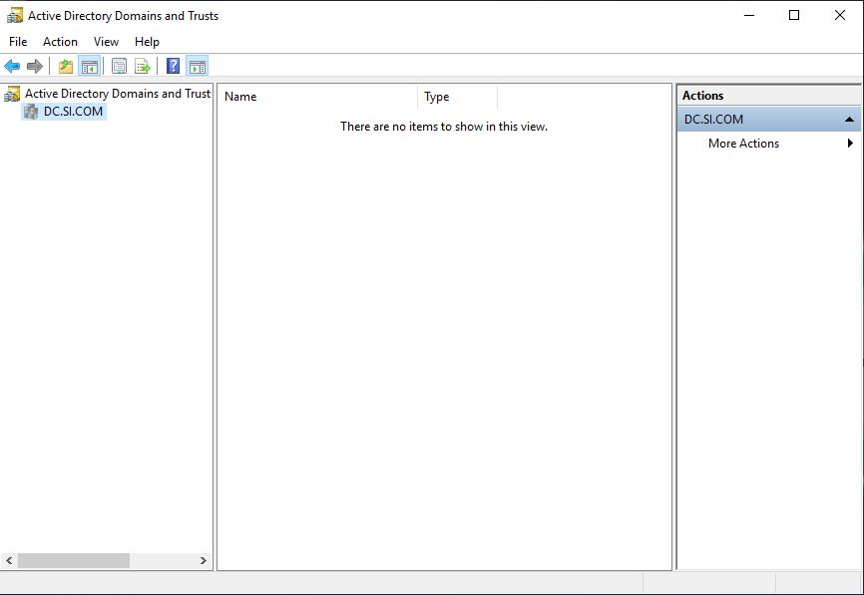
Active Directory Domains and Trusts
This tool is generally only used in larger environments that have more than one domain within the same network.

Slide 56
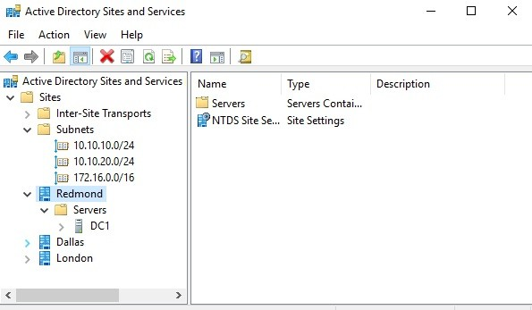
Active Directory Sites and Services
Large Environments
Two DC
Sites

Slide 57
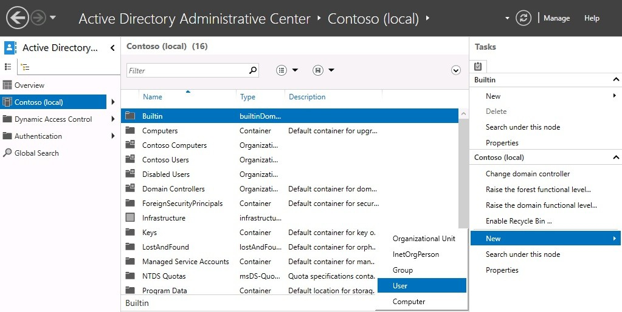
Active Directory Administrative Center
Familiar User Interface

Slide 58
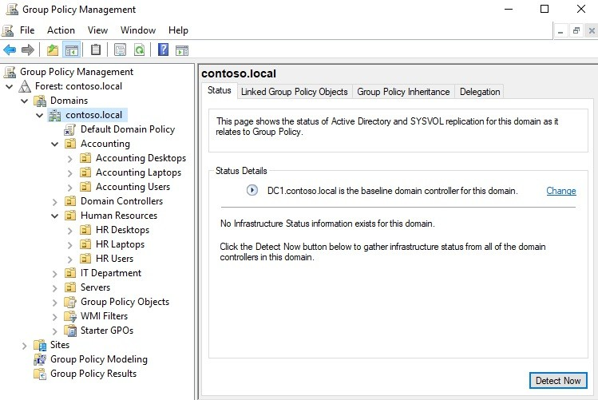
The power of Group Policy
It enables you to create Group Policy Objects (GPOs) that contain settings and configurations that you want to apply to either computers or users in your Active Directory domain.

Slide 59
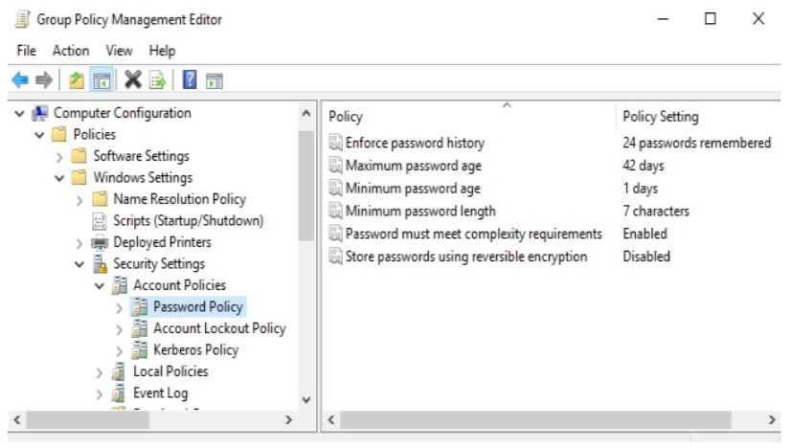
The Default Domain Policy
This GPO is plugged into Active Directory by default during installation, and it applies to every user and computer that is part of your domain directory.

Slide 60
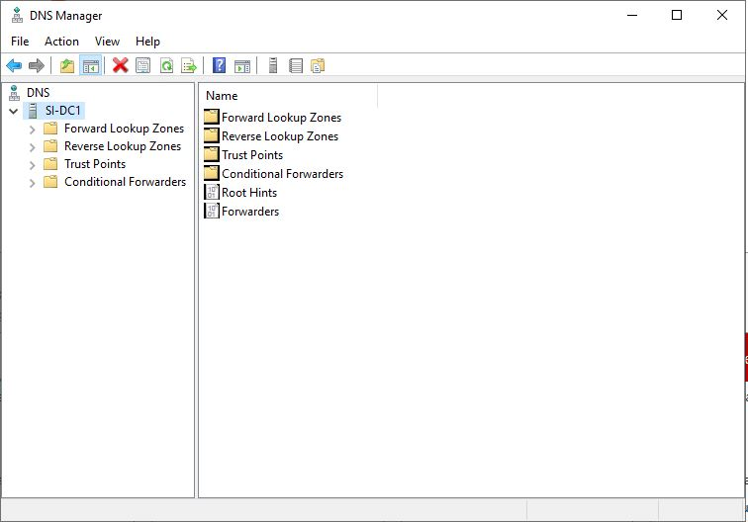
Domain Name System (DNS)
If we consider Active Directory Domain Services to be the most common and central role in making our Microsoft-centric networks function, then the Domain Name System (DNS) role slides in at number two.

Slide 61
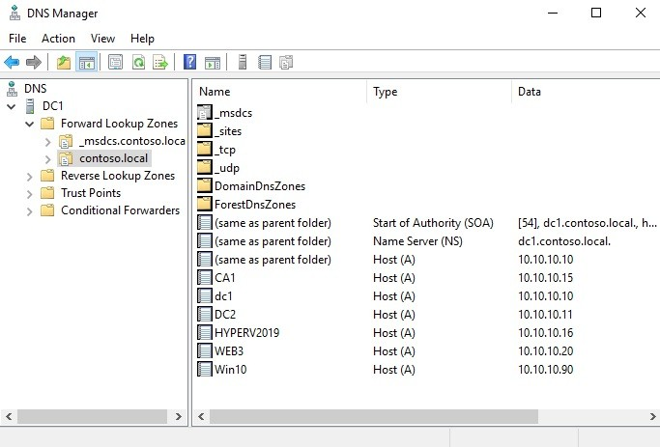
Different kinds of DNS records
Host record (A or AAAA)
ALIAS record – CNAME
Mail Exchanger record (MX)
Name Server (NS) record

Slide 62
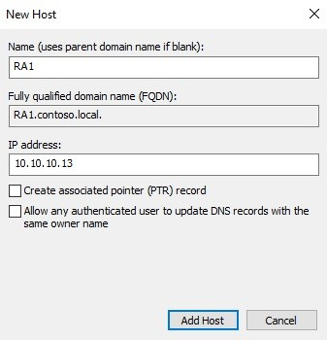
Host record (A or AAAA)
A host record is the one that resolves a particular name to a particular IP address.
A record – IPv4
AAAA Record – IPv6

Slide 63
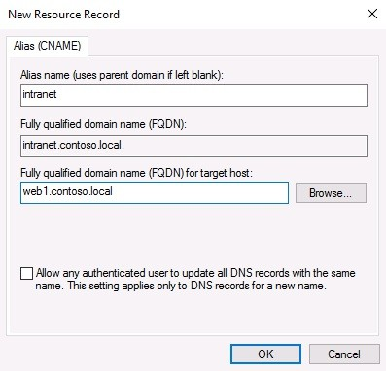
ALIAS record - CNAME
Point name to another name
Intranet Example

Slide 64
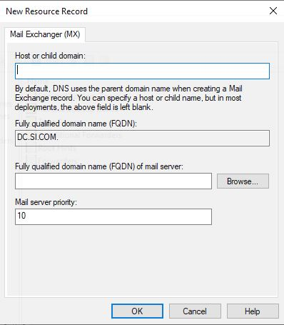
Mail Exchanger record (MX)
An MX record is all about email services and delivery.

Slide 65
Name Server (NS) record
An NS record is an identifier within a DNS zone that tells it which Name Servers (which are your DNS servers) to use as the authorities for that zone.

Slide 66
DHCP versus static addressing
Static addressing is simply the process of configuring IP addresses on your system manually, using your own hands as the configuration tool in order to plug all of your IP address information into the NIC settings on that device.
Dynamic Host Configuration Protocol (DHCP).
This is a protocol that is designed to solve our exact problem by providing the ability for machines and devices to be plugged into your network and automatically obtain IP addressing information.

Slide 67
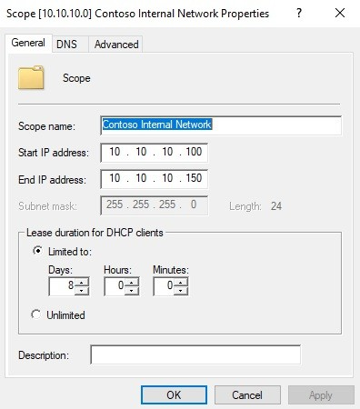
The DHCP scope
IP Address / Range
Subnet Mask
Default Gateway
DNS
Lease Time

Slide 68
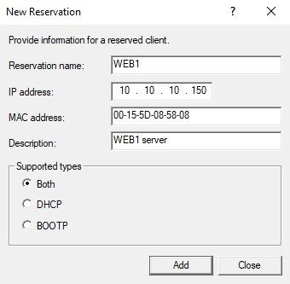
DHCP reservations
Lease Time
Different IP Address

Slide 69
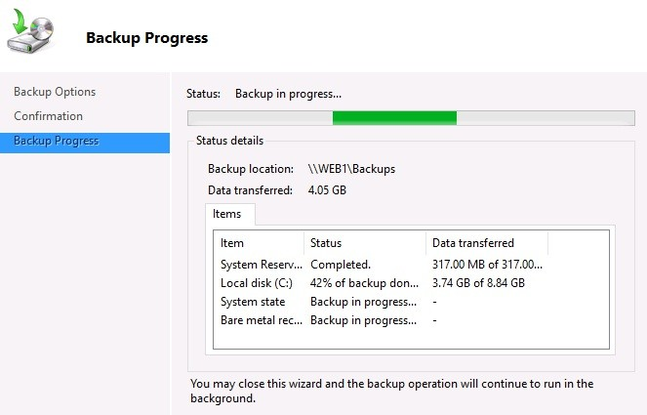
Back up and restore
Full
Incremental
Differential
Schedule
Automate

Slide 70
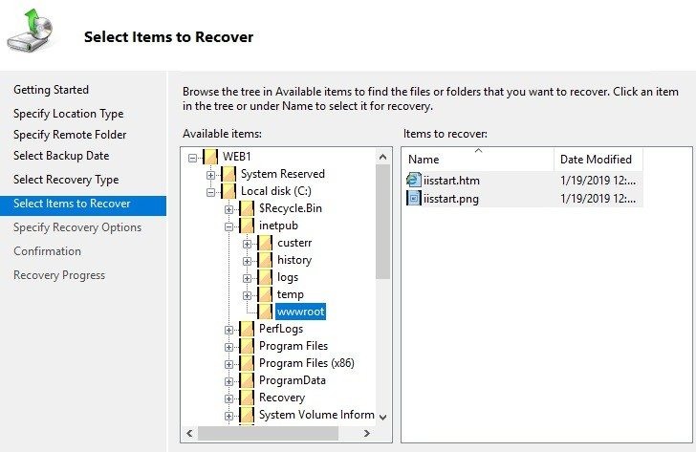
Back up and restore
Restoring from Windows

Slide 71
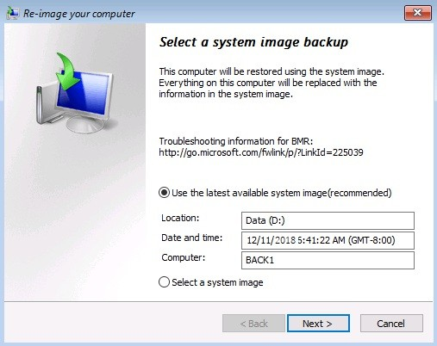
Back up and restore
Restoring from the installer disc

Slide 72
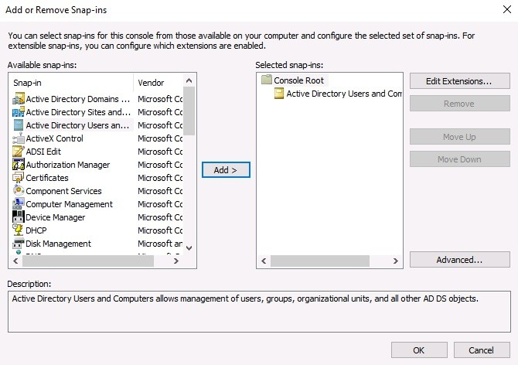
MMC and MSC shortcuts
SA.MSC: Active Directory Users and Computers
DSSITE.MSC: Active Directory Sites and Services
DNSMGMT.MSC: DNS Manager
GPEDIT.MSC: Local Group Policy Editor
GPMC.MSC: Group Policy Management Console
CERTSRV.MSC: Certification Authority Management
CERTTMPL.MSC: Certificate Template Management
CERTLM.MSC: Local Computer Certificates Store
CERTMGR.MSC: Current User Certificates Store
COMPMGMT.MSC: Computer Management
DEVMGMT.MSC: Device Manager
DHCPMGMT.MSC: DHCP Manager
DISKMGMT.MSC: Disk Management
EVENTVWR.MSC: Event Viewer
PERFMON.MSC: Performance Monitor
SECPOL.MSC: Local Security Policy Console
FSMGMT.MSC: Shared Folders
WF.MSC: Windows Defender Firewall with Advanced Security

